Slide 1
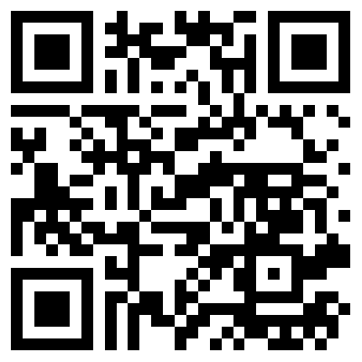
Life in the fAST Lane

Slide 2
Common language / terminology
Dynamic Application Security Testing (DAST) | Sending requests to running web applications and then observing & analyzing the application’s behavior.
Static Application Security Testing (SAST) | Analysis of the source code, in its a non-execution environment, for patterns & anti-patterns that indicate a potential security issue.
Contextual Security Analysis (CSA) | A modern, comprehensive risk assessment of software changes using a multitude of factors/data-points.
AI / LLM | Witch magic

Slide 3
SAST CSA + AI
A Brief History: SAST & Me
Practical use cases
Language examples:
Node.js + Babel
Python + ast
Introducing Contextual Security Analysis
S.L.I.D.E.
Integrating patterns into AI
Code examples of performing analysis

Slide 4
A Brief History:
Static Application Security Testing (SAST)
&
Me

Slide 5

Ken Johnson
@cktricky
Co-Host of Absolute AppSec
CTO of DryRun Security
BJJ Nerd

Slide 6
A Brief History: SAST A Brief History: Me
1995 JavaScript released | I was released… into 7th grade 🤮
The first SQL Injection vulnerability discovered in 1998 | Thankfully, Gateway PCs were all the rage. Discovered how much I loved computers,
2001 OWASP founded, Mark Curphey | 2001 I go into the US Navy to become an IT
2002 Ounce Labs formed, sold to IBM in 2009. 2003 Fortify formed, sold to HP in 2010. 2006 Veracode, sold in 2022 to TA Associates. 2006 CheckMarx Founded. Sold in 2020 to Hellman & Friedman. | 2001-2007 Learn a bunch, leave the navy, work professionally in IT. Code/Hack at night/weekends for a hobby. Learned SQL, HTML, Ruby, etc.

Slide 7
A Brief History: SAST + Me
2008 - 2012 AppScan Source, Fortify, and Veracode dominate the SAST space | 2008-2010 - Offered a contracting job for Pentagon (AppSec… before appsec) 2010-2012 - Consultant at Fishnet Security using Ounce Labs / AppScan Source
2012 Dependency check released, added to OWASP 2013 Top 10 (A9) 2013 Brakeman released as OSS, SAST for Ruby on Rails 2015? Retire.js OSS is released for JavaScript | 2012-2013 LivingSocial AppSec Manager 2013 - 2017 CTO of nVisium
IMPORTANT!!!

Slide 8



Why is this important?
FREAKING OSS?! AMAZING 😍
OWASP Top 10 A9: Using Known Vulnerable Components.
Dependencies are now being analyzed.
Retire.js contributes to this as well… mostly JQuery focused but still
Brakeman really demonstrates the power of combining flow control AST with a highly opinionated framework (Ruby on Rails)

Slide 9
A Brief History: SAST A Brief History: Me
2015 Snyk founded, 2017 started really gaining momentum with developers | 2017 I ended my journey as CTO, began my journey as an IC on GitHub’s AppSec team
2019 r2c is a company, 2020 rebrands sgrep to Semgrep | 2018 Seth & Ken’s excellent adventures course launched; preaching an agnostic approach to code review. Clint Gibler & Leif Dreizler are students in the first course. Both go on to join Semgrep.
Semmle (CodeQL) acquired by GitHub 2019 | GitHub team begins uses this tooling and CodeQL becomes a part of GitHub Advanced Security.

Slide 10
Takeaways…
🧑‍💻SAST Tools built & marketed with developers in mind
⚡️ Some tooling provides a somewhat language agnostic approach to SAST, quick way to write rules (Semgrep)
⚙️Others are very highly tuned (CodeQL) and accurate but difficult to extend
🖥️ Integrated more closely into the development pipeline
🙅‍♂️Perfection in SAST does NOT exist, use it for what its worth

Slide 11
Conclusion
🧐
Write something:
✅ Familiar to developer’s so that they can easily extend & use
✅ Harnesses existing tooling & pipeline
✅ Balance between speed and perfection

Slide 12
Practical Use Cases

Slide 13
Practical Use Cases
Awareness:
Looking for changes in security impacting policies and configurations
Variant Analysis:
Looking for similar issues that have cropped up in the past
Regression analysis:
Looking for areas where regression may occur

Slide 14
Write your own

Slide 15
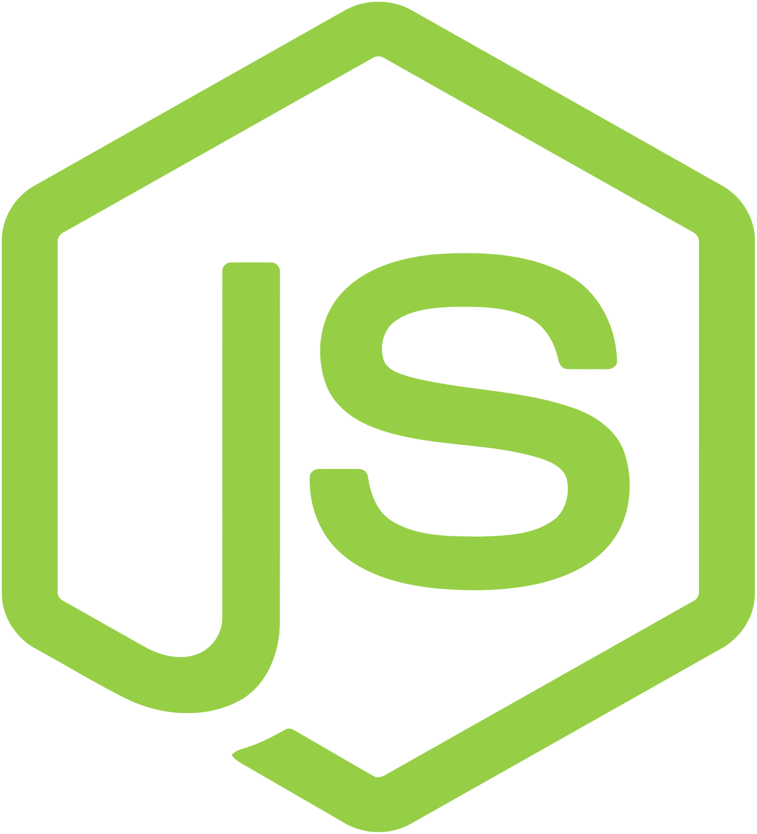
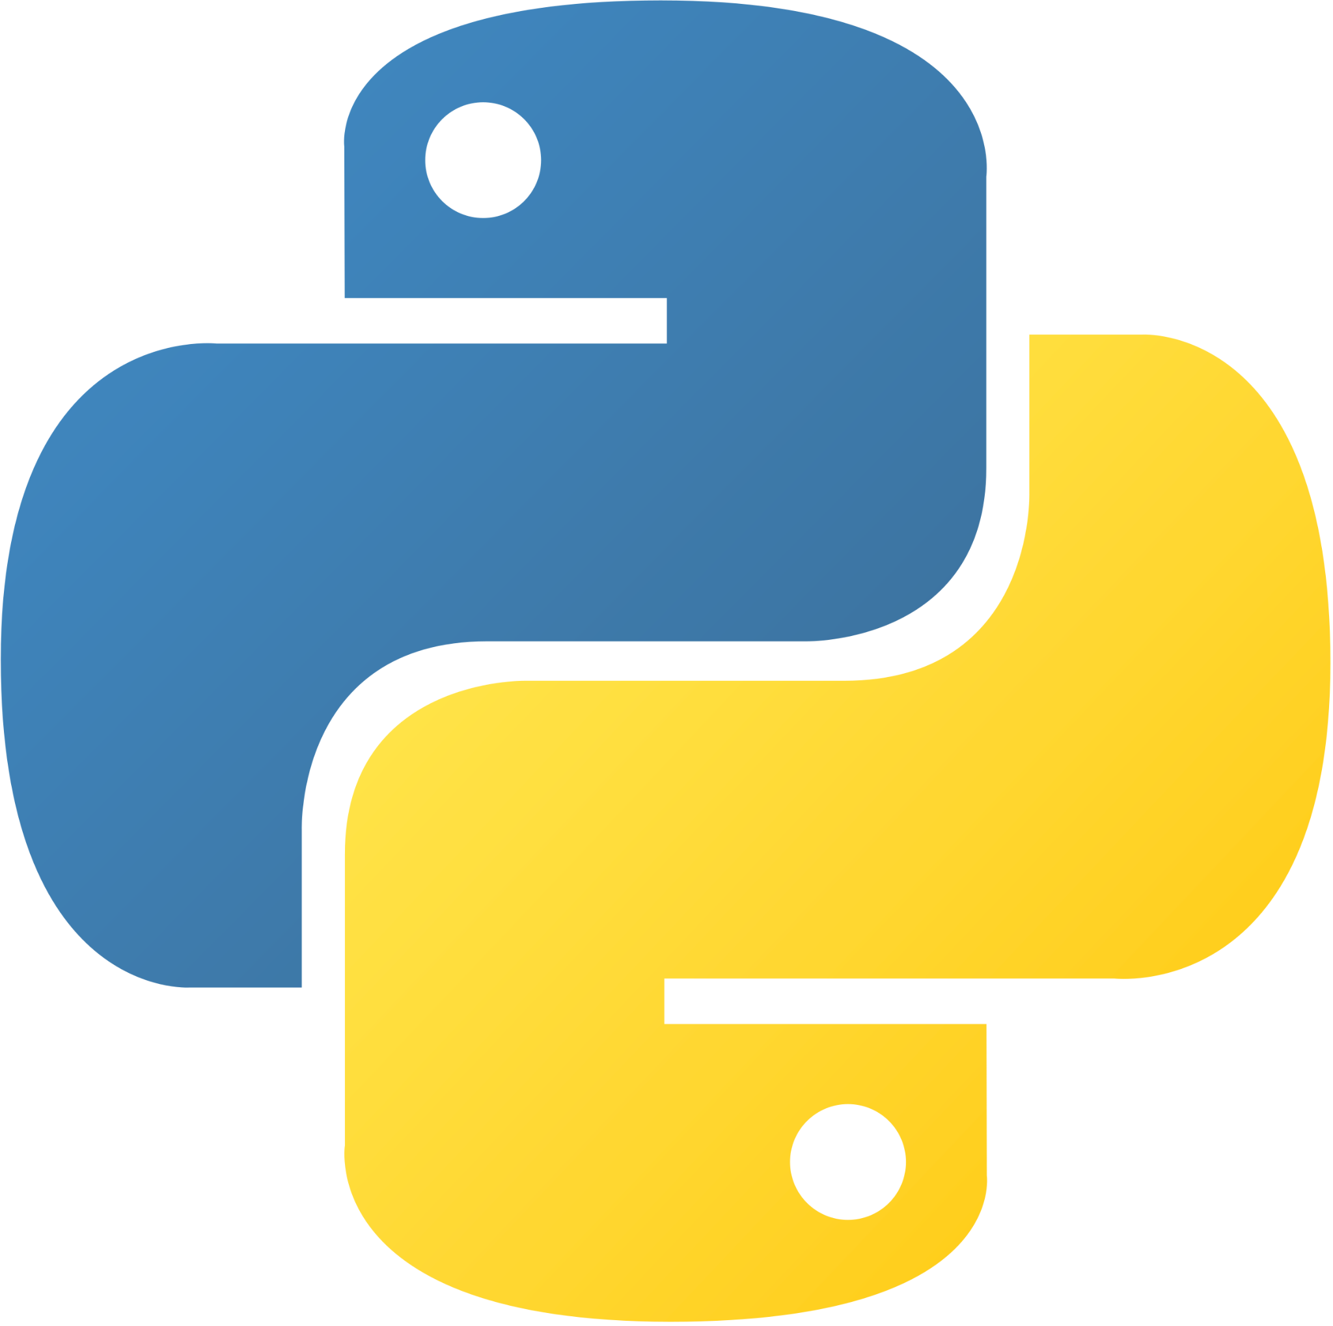


Overview / Outline
JavaScript & TypeScript + Babel.js
Python + AST
Ruby + sexp

Slide 16
JS/TS - Babel.js

Slide 17
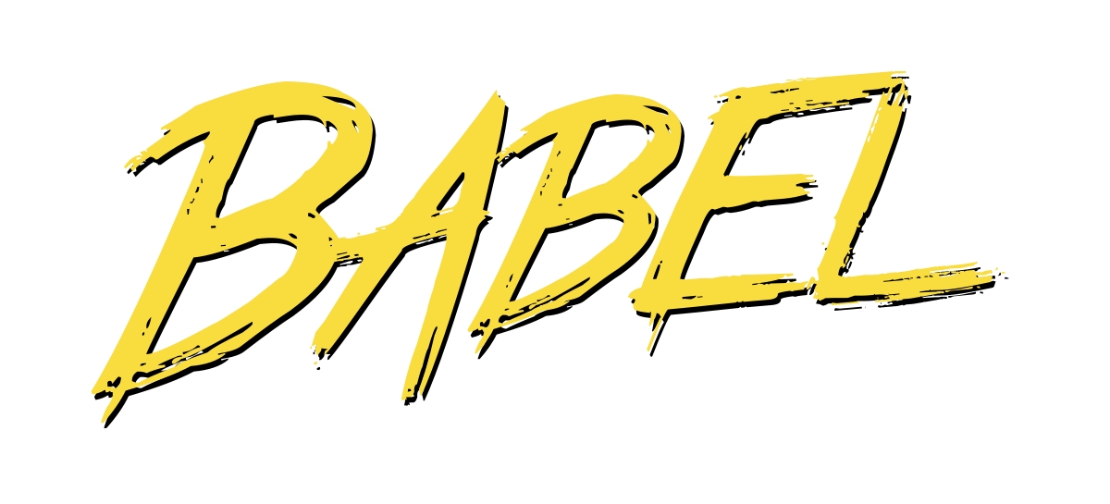
Babel.js
Features:
Modular - You can run multiple rules at once
Handles various major versions of JS
Includes transpiling when conversion is necessary
Home Page: https://babeljs.io/

Slide 18
Important Terminology
Abstract Syntax Tree | Converts source code into chunks with specific instructions and format that can be traversed to look for patterns.
Parse - @babel/parse | Parses the source code and converts to an AST. Supports JSX, Flow, and Typescript.
Traversal - @babel/traversal | Traverses the Abstract Syntax Tree generated by parsing the source code. You provide rules (ie - patterns) to this function and it returns any discovered matching patterns.
Types - @babel/types | Convenience functions for traversing AST and identifying relevant nodes

Slide 19
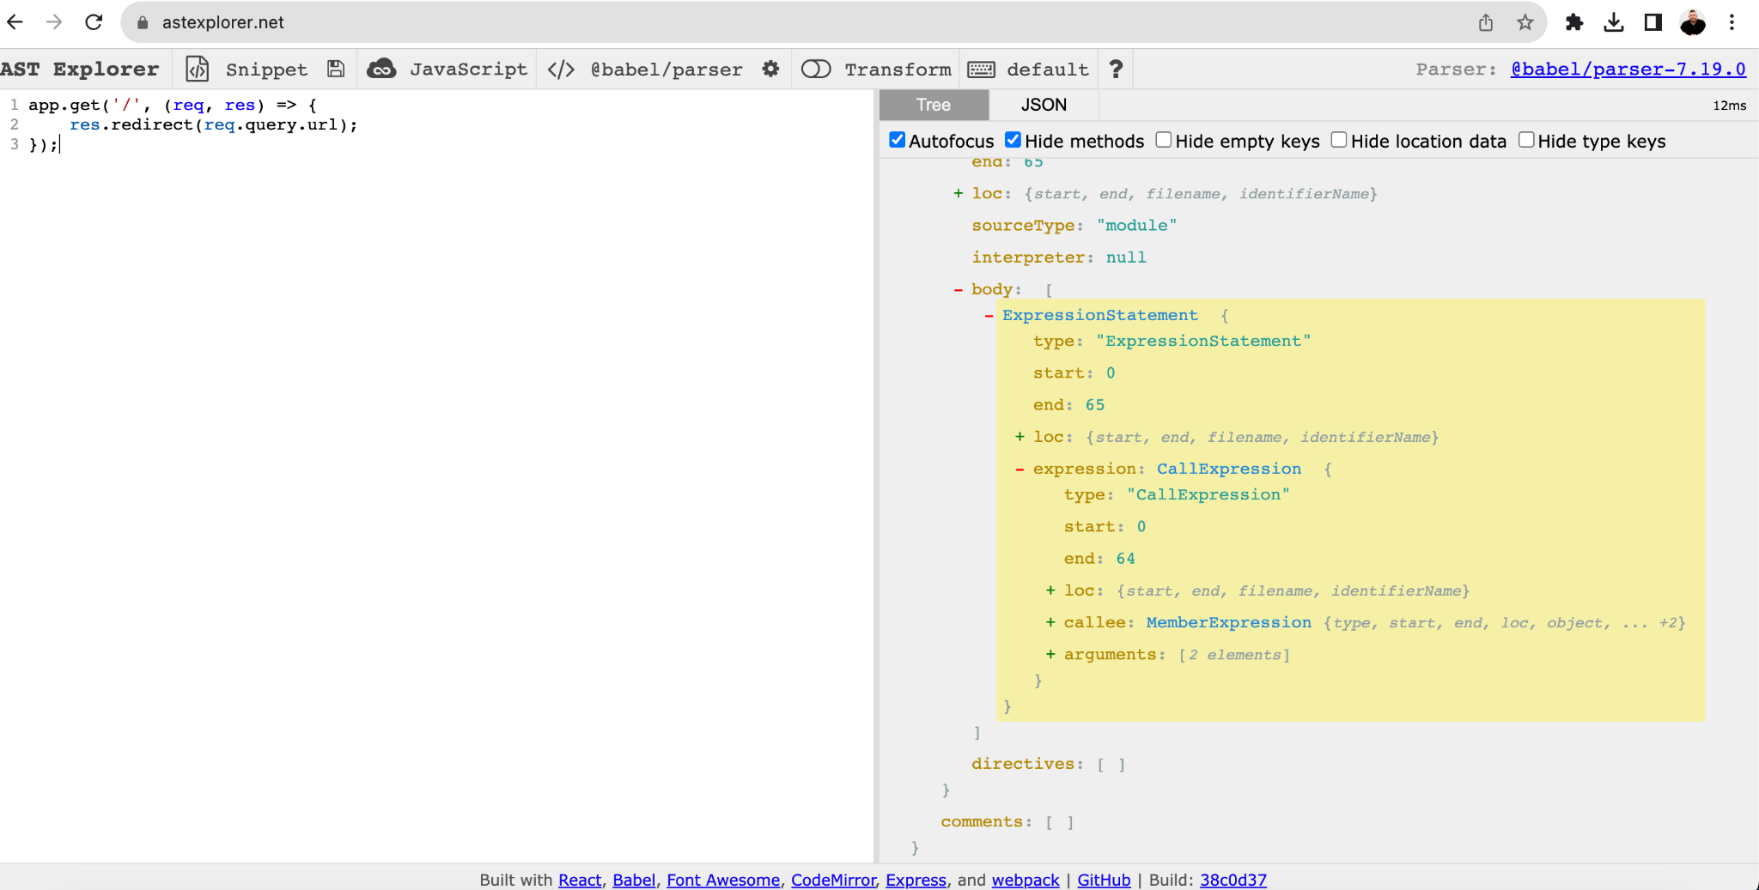
Helpful tool to visualize an AST in JS/TS
ASTExplorer.net
Homepage: https://astexplorer.net

Slide 20
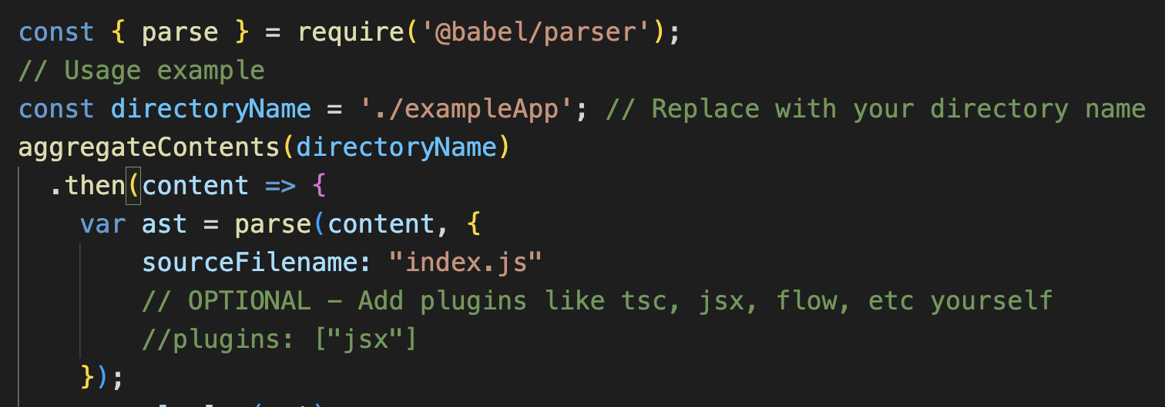
Parse source code

Slide 21
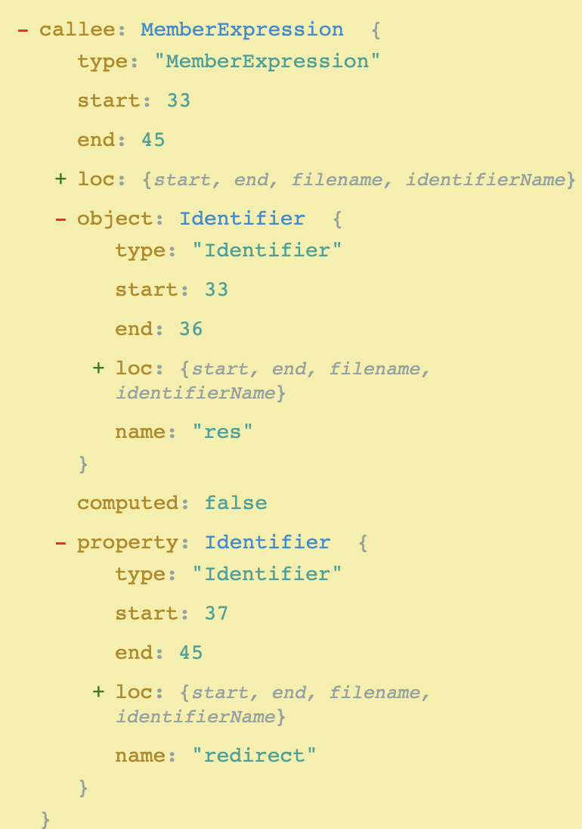
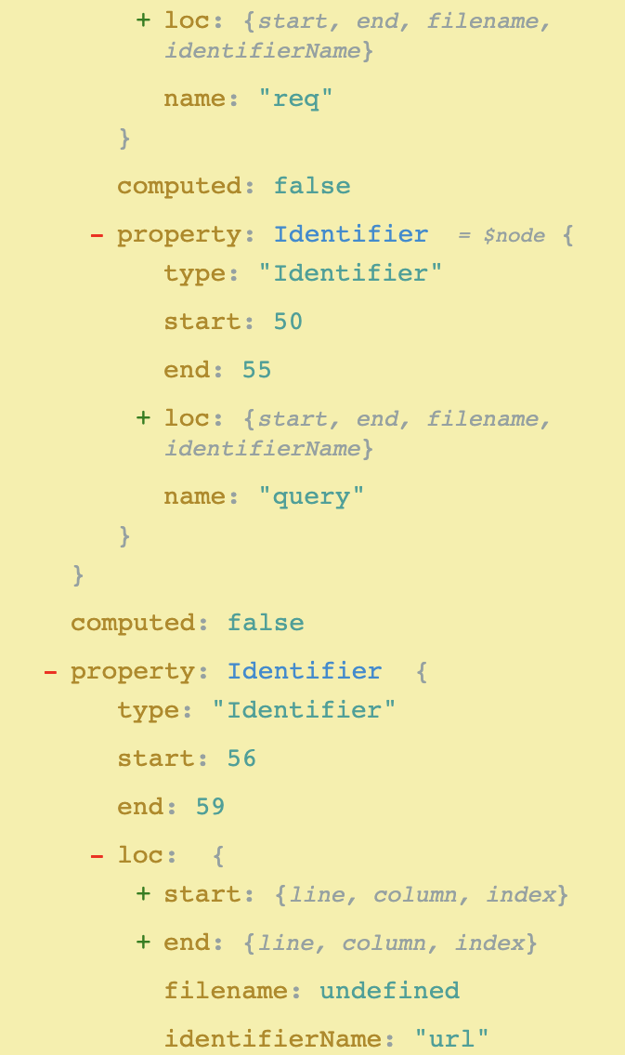
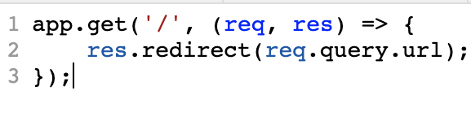
Traverse the AST

Slide 22
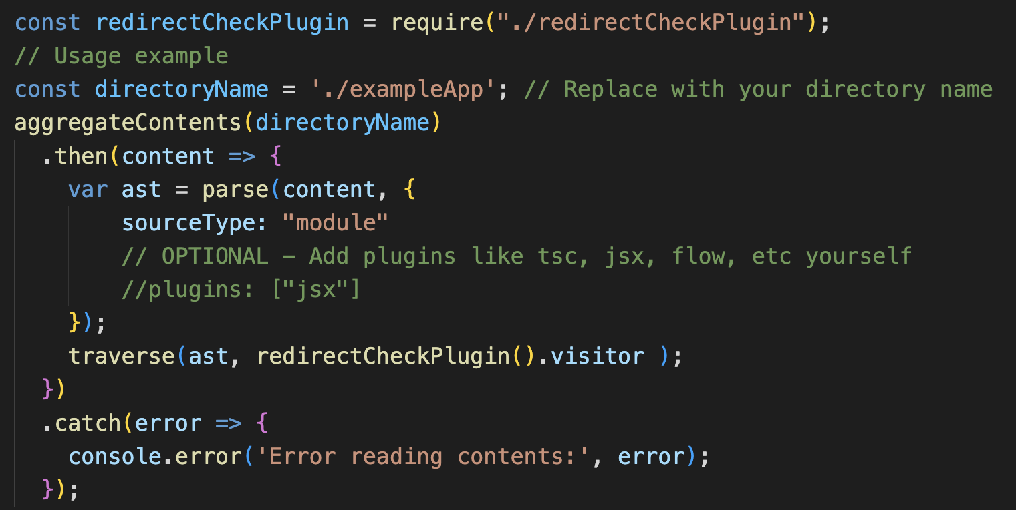
Traverse the AST

Slide 23
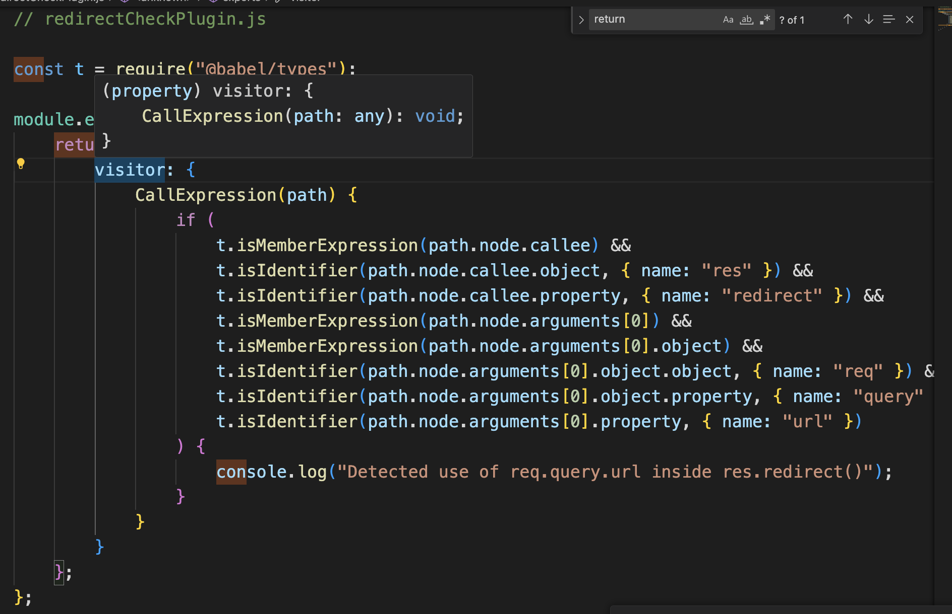
Traverse the AST

Slide 24
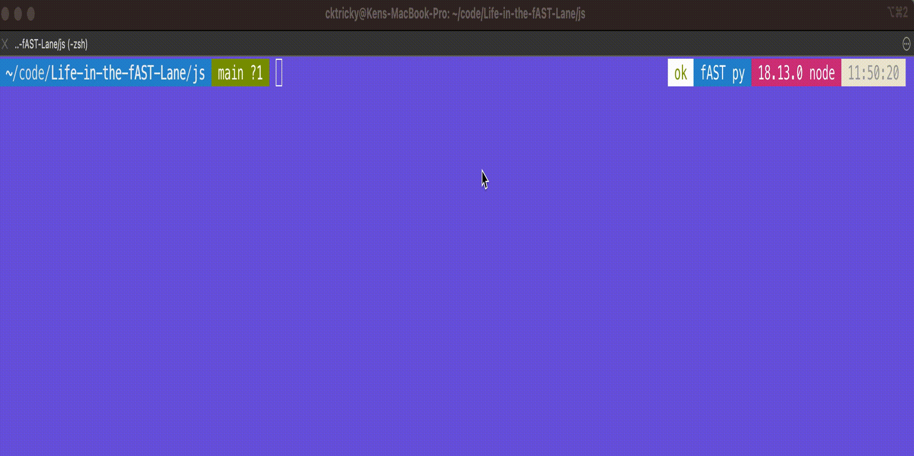

Slide 25
Actualize Results - GitHub
<show octokit posting check run and annotations>

Slide 26
ast - Python

Slide 27
Important Terminology
Visitor | The Python/ast equivalent of traversal in Node/Babel.js. Allows you to walk the AST looking for nodes that match a specific pattern.
node | Same as JS, this represents a chunk of code
node.func | References a function call

Slide 28

ast
Features:
Built-in! Makes deployment easy :-) Modular - You can run multiple rules at once
Can be run from an interactive session (terminal)
Similar to Babel, parses source code, generates an AST, and allows you to traverse (visit) the tree
Home Page: https://docs.python.org/3/library/ast.html

Slide 29
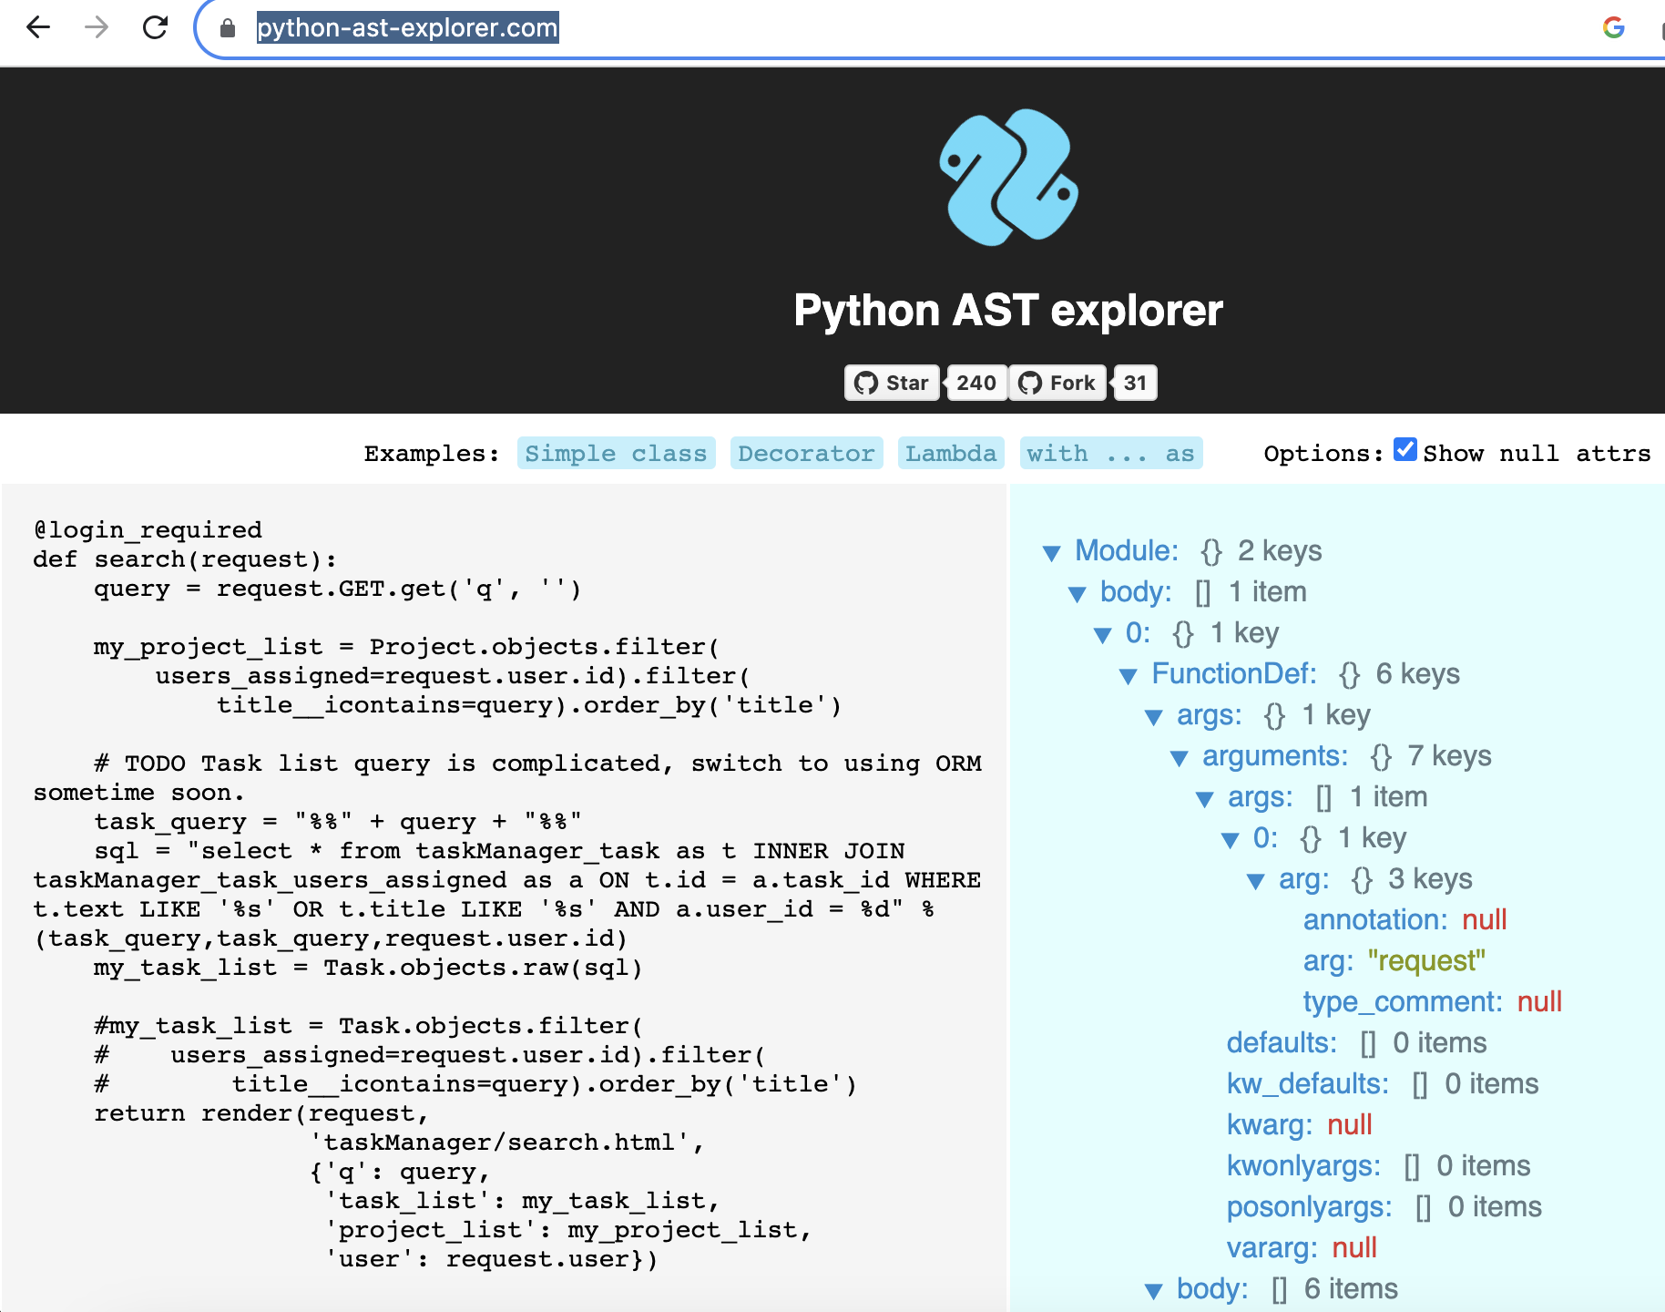
Helpful tool to visualize an AST in Python
Python AST Explorer Homepage: https://python-ast-explorer.com/

Slide 30
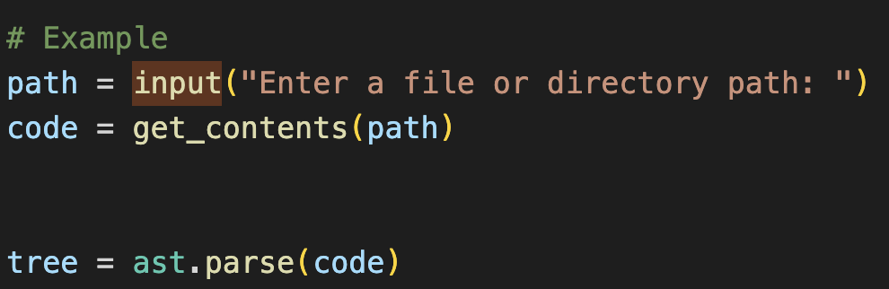
Parse source code

Slide 31
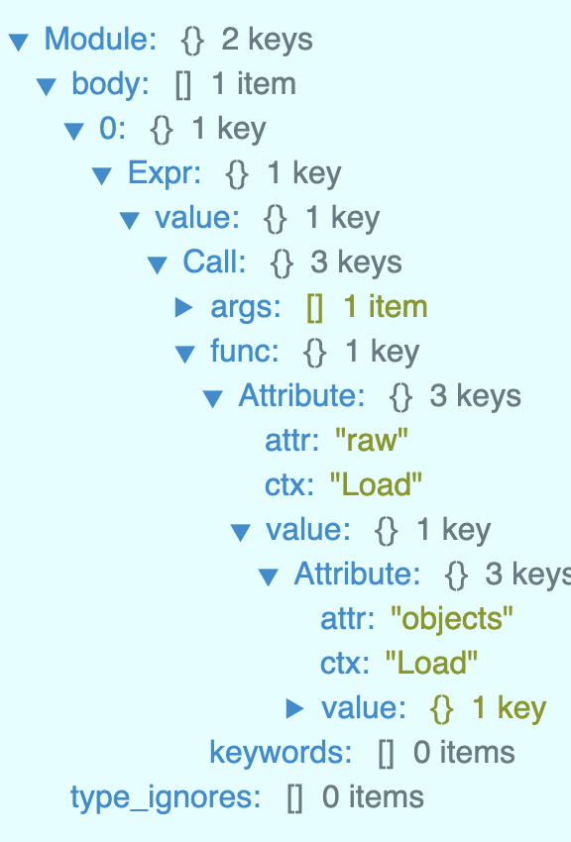
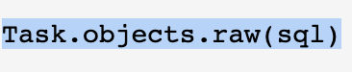
Traverse (Visit) the AST
Python AST Explorer

Slide 32
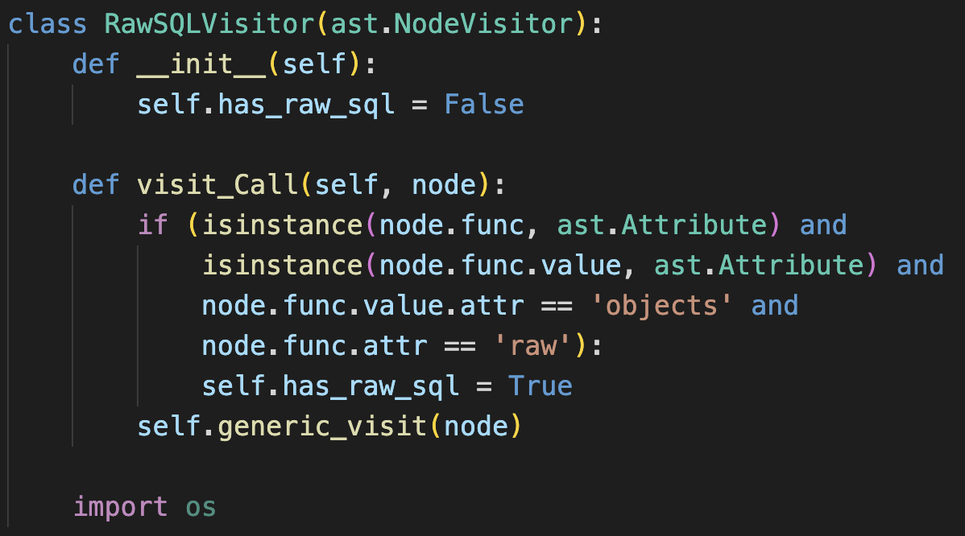
Traverse the AST

Slide 33
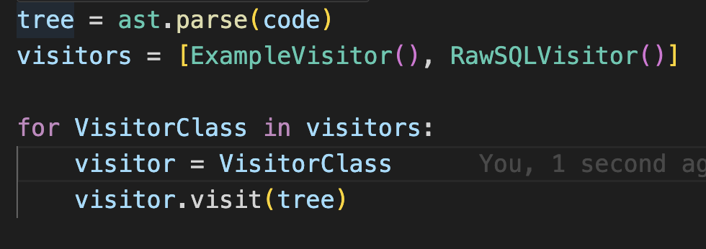
Loading multiple rules

Slide 34


Slide 35
Final thoughts on building your own SAST
🔮Know what you’re trying to use it for
🧰Integrate into existing tooling and processes
📊 SAST is a very useful data point but it is but one of many available to us
🥊Combine SAST results with additional factors that represent risk

Slide 36
Contextual Security Analysis

Slide 37
Context > Control

Slide 38
Control Context
(S,D,I)AST embodies this:
😭Limited data points
😭Enforcement of rules
😭Blocking checkpoints 😭Pattern matching
Next Gen:
😍Combines many data points
😍Warnings & guidance over enforcement
😍 Remediation guidance
😍 Risk-focused
Download Link: https://www.dryrun.security/resources/csa-guide

Slide 39
CSA - SLIDE 🛝
Surface | How the surface of the application changes
Language | Language and framework that the application is written in
Intent | Evaluates the person making the change, both in their patterns and their purpose
Detection | Tooling in place to detect vulnerabilities and security issues
Environment | Purpose of the application and service in the organization

Slide 40
SLIDE - Surface
⚠️Sensitive Code Paths
🚧 HTTP Routes
Depending on your language and framework, this could be configuration files, middleware, controllers, or how your application and service handles auth.
Routes refers to an exposed endpoint on an application that will take user-supplied information and perform an action. Expansion or contractions of these routes in an application inherently change the risk profile of the application.

Slide 41
SLIDE - Language
💬Source Language
🧱Web Framework
This weighs the language used (ex: Golang, Rust, PHP, etc.) as each has their own security issues and known vulnerabilities.
Each web framework contains their own unique variations of sensitive areas, configurations, and components. Framework nuances are subtle and highly specific security issues that are akin to “footguns” 🦶🔫.

Slide 42
SLIDE - Intent
📡 Authorship frequency
🫅Author is not an owner
If the author rarely commits or has never committed to this repo this indicates the author may be unfamiliar with the development standards of the code base.
Code changes to a portion of code in which the author is not an owner or on a team that owns this portion of the code.

Slide 43
SLIDE - Detection
🤐 Secrets
👩‍🔬 Testing
Secret scanning technology has enabled the detection of sensitive keys when pushed in source code. This is a major indicator of risk in a code change.
Consuming (S|D)AST, dependency, docker image, etc. scanner tool output. Past bug bounty submissions as a historical reference to known dangerous anti-patterns. Similar concept with vulnerabilities Identified by internal/external security contributors.

Slide 44
SLIDE - Environment
💪 Change protection
👩‍💼 Business Risk
Does the application utilize branch protection features or other testing-relevant gating mechanisms to ensure evaluation of new code changes?
Critical factors include the level of risk a service poses through its business function, the type of data it processes/stores/transmits, and its overall importance to the business.

Slide 45
AI / LLMs

Slide 46
Personal recommendations
🔬🧪Start experimentation with Baseplate or something similar
📖 Read this article:
https://engineering.peerislands.io/extending-openai-gpt-4-using-langchain-and-pinecone-for-q-a-over-your-own-content-using-1f3e9dc10e91
📖 Read this book:
https://www.amazon.com/What-ChatGPT-Doing-Does-Work/dp/1579550819

Slide 47

Langchain
Modular Components
LLMs
Compressors
Retrievers
Prompts
Chains
… and way more
+

Slide 48
My AI learnings…
Contextual Compression + Documents, Chains, LLMs, Prompts… they are all highly configurable and can be very accurate
Created the following:
AI Chat bot assistant that can dig through your organization’s secure code docs to answer questions
Analysis agent that provides composition of the application (framework, language, security centric libraries, datastore, etc.)
Analysis agent that looks for known (in your app’s specific code base) security bug patterns

Slide 49
Conclusion

Slide 50
Things are changing… they must
💡 Too many technology choices to continue testing in isolation using a single data point to determine risk
💡 The power is in your hands to build your own highly customized tooling
💡 Meet developers where they live
💡 AI / LLM can be a for multiplier; is NOT a silver bullet

Slide 51

Contact Info
@cktricky
ken@dryrun.security
youtube.com/@AbsoluteAppSec

Slide 52
Whitequark Parser - Ruby

Slide 53

ast
Features:
Built-in! Makes deployment easy :-) Modular - You can run multiple rules at once
Can be run from an interactive session (terminal)
Similar to Babel, parses source code, generates an AST, and allows you to traverse (visit) the tree
Home Page: https://docs.python.org/3/library/ast.html

Slide 54
Important Terminology
Abstract Syntax Tree | Converts source code into chunks with specific instructions and format that can be traversed to look for patterns.
Parse - @babel/parse | Parses the source code and converts to an AST. Supports JSX, Flow, and Typescript.
Traversal - @babel/traversal | Traverses the Abstract Syntax Tree generated by parsing the source code. You provide rules (ie - patterns) to this function and it returns any discovered matching patterns.

Slide 55
Helpful tool to visualize an AST in Ruby

Slide 56
Parse source code

Slide 57
Traverse the AST

Slide 58
Loading multiple rules

Slide 59
Run Rules

Slide 60
Actualize Results - GitHub
<show octokit posting check run and annotations>

